Slide 1

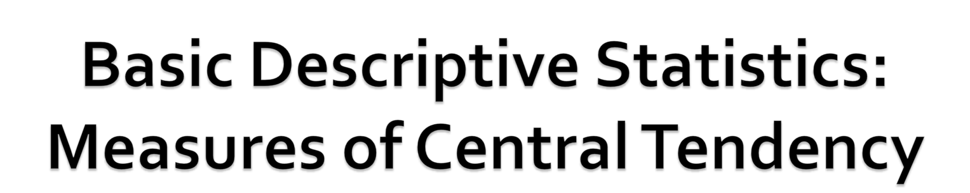
Numeracy & Quantitative Methods:
Numeracy for Professional Purposes
Laura Lake

Slide 2
Recap: univariate analysis
Descriptive statistics – conducting analysis on one variable at a time or univariate analysis.
Common approaches to univariate analysis:
  Measures of distribution
  Measures of central tendency
  Measures of dispersion
Notes:
When using descriptive statistics we are usually conducting univariate analysis – analysis of one variable at a time, so describing the characteristics of each variable.
Last lecture we looked at measures of distribution. This series of slides will look at measures of central tendency.

Slide 3
Measures of central tendency
Measures of central tendency: quantification of the location of the middle or centre of a data set – what the typical or average score/ result of a data set is.
So, identifying a typical value that best summarises the distribution of values in a variable.
There are three main different measures:
  Mean
  Mode
  Median
Notes:
Measures of central tendency: attempt to quantify the location of the middle or centre of the data – what the typical or average score/ result of a data set is.

Slide 4
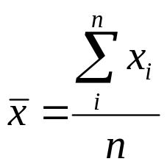
Measures of central tendency
Type | Description
Mode | Most Frequently occurring value/category
Median | Arrange all values in rank order Median = middle = 50th percentile
Mean (arithmetic) or ‘average’ | Sum of all the values in a distribution, divided by the number of cases.
Choice of statistical tool is dependent on the level of measurement of the variable.
Notes:
The choice of which measure to use to describe a particular variable is dependent on the Level of Measurement of the variable – nominal, ordinal, interval and ratio – as discussed in the second lecture ‘ Types of Data’.

Slide 5
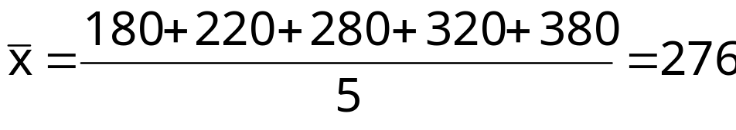
Mean (arithmetic)
Mean (arithmetic) is the sum of all the values in a distribution, divided by the number of cases – the average.
Example:
Weekly income of 5 people:
Using the mean formula:
Mean is calculated as:
Mean income is: £276.
£180 | £220 | £280 | £320 | £380

Slide 6
Median
Median is the midpoint in a distribution, when arrange in ascending or descending order.
Example:
Weekly income of 5 people:
Median is: £280.
£180 | £220 | £280 | £320 | £380

Slide 7
Median
Where there is an even number of observations the median will be the average of the two middle values.
Example:
Weekly income of 6 people:
Median is: (280+300)/2= £290.
£180 | £220 | £280 | £300 | £320 | £380
Notes:
The median is sometimes used instead of the mean to negate against extreme values – we talk about this in the next lecture.

Slide 8
Mode
Mode is the most frequently occurring value in a variable.
Example:
Weekly income of 10 people:
Mode is £280 (occurs in 3 of the 10 cases).
£180 | £220 | £280 | £320 | £280 | £180 | £350 | £280 | £330 | £220
Notes:
Mode is £280 as it occurs in 3 of the 10 cases. Every other value occurs either once or twice.

Slide 9
Mode
Bi-modal: two most frequently occurring values in a distribution (two pronounced views or patterns of response).
Multi-modal: where there are more than two modes in a distribution (potentially several pronounced views or patterns of response).
Notes:
We will look at distributions in the sixth lecture of this series.

Slide 10
Appropriate measure
Level of measurement | Measure of central tendency
Nominal | Mode
Ordinal | Median and mode
Interval/Ratio | Mean, median and mode
Notes:
As discussed in Lecture 2: Data Types –
Nominal variables or categorical data is data that comprises of categories that cannot be rank ordered – each category is just different. Therefore you cannot measure the distance between values (i.e. Male and female) and so they have no mathematical qualities. Therefore, you cannot use median and mean – all you can say is how often the values occur and which occurs the most frequently (the mode).
Ordinal variables are the next hierarchical level up from nominal data and like nominal data, the data is based on categories. But the difference is that they can be ranked and ordered i.e. from good to bad or agree to disagree. Therefore, the same measure of mode can be used with the addition of the median – the middle occurring value or category.
Up from ordinal data in the hierarchy is interval and ratio data. In addition to the ability to be ranked (as with ordinal data) the distance between each value with interval and ratio data can be measured i.e. difference between 1.5m and 1.6m. Therefore, it can use all those for ordinal data (mode and median) with the addition of the mean. The mean requires actual mathematical values to calculate an average so scale data (interval and ratio) is the only varaible type to provide a single mathematical value for each observation.

Slide 11
Other univariate analysis
Next lecture will cover:
  Measures of distribution
  Measures of central tendency
  Measures of dispersion

Slide 12
References
Bryman, A. (2008) Social Research Methods. 3rd Ed. Oxford: Oxford University Press.
David, M. and Sutton, C. (2011) Social Research : An Introduction. 2nd ed. London: Sage.
Notes:
Click to add notes

Slide 13


This resource was created by the University of Plymouth, Learning from WOeRk project. This project is funded by HEFCE as part of the HEA/JISC OER release programme.
This resource is licensed under the terms of the Attribution-Non-Commercial-Share Alike 2.0 UK: England & Wales license (http://creativecommons.org/licenses/by-nc-sa/2.0/uk/).
The resource, where specified below, contains other 3rd party materials under their own licenses. The licenses and attributions are outlined below:
  The name of the University of Plymouth and its logos are unregistered trade marks of the University. The University reserves all rights to these items beyond their inclusion in these CC resources.
  The JISC logo, the and the logo of the Higher Education Academy are licensed under the terms of the Creative Commons Attribution -non-commercial-No Derivative Works 2.0 UK England & Wales license. All reproductions must comply with the terms of that license.
Author | Laura Lake
Institute | University of Plymouth
Title | Numeracy & Quantitative Methods Numeracy for Professional Purposes
Description | Basic Descriptive Statistics: Introduction
Date Created | May 2011
Educational Level | Level 4
Keywords | Learning from WOeRK Work Based Learning WBL Continuous Professional Development CPD Research UKOER LFWOER Measures of central tendency, mode, median, mean.
  ©University of Plymouth, 2010, some rights reserved
Back page originally developed by the OER phase 1 C-Change project

